Slide 1
Historical Study of Incidence Reports in San Francisco
By
Kenneth Fiawoyife and Sai Sudheer Maddukuri

Slide 2



Introduction: Problem Statement
Thousands of crimes are reported in big cities like San-Francisco.
Crimes range from mild misdemeanours to more serious crimes.
San Francisco like a lot of big cities in the USA, are facing understaffing in the police force.
Source: https://issuu.com/outlookpublishing/docs/san-francisco-police-department
Source: https://www.cntraveler.com/destinations/san-francisco

Slide 3


Introduction: Issues With An Understaffed Police Force
Increased response times to emergency calls.
Decrease in crime prevention
Community relations strain
Decrease in Officer Morale
Source: https://www.cntraveler.com/destinations/san-Source: https://www.dailymail.co.uk/news/article-2054127/500-000-crimes-committed-repeat-offenders-half-carried-career-criminals-25-previous-offences-each.html
Source: https://www.shutterstock.com/search/police-officer-tired

Slide 4

Proposed Solution: Review of Incident Reports
Reviewing of historical data provided by incident reports.
Reports to be categorized into initial reports, supplemental reports, coplogic reports and vehicle reports.
Data to be retrieved for San Francisco from 2018 to present
Data to then be cleaned & statistically analyzed.
Analyzed data to be used to create a visualization solution that informs of crime rates and distributions across the various districts in San Francisco
Source: https://flowdit.com/incident-report/

Slide 5

Proposed Solution- Benefits
Resource allocation & response optimization
Identifying trends and community needs
Community engagement and trust building
Improved interagency Collaboration
Source: https://stockcake.com/i/community-policing-interaction_190150_33451

Slide 6
Methodology - Overview
Data Collection(SFPD Crime Data Warehouse)
Initial Reports
Supplemental Reports
Coplogic Reports
Vehicle Reports
First reports filed for an incident
Follow up report to an initial, coplogic or vehicle report
Incident reports filed by the
public using SFPD’s online reporting system
Incident reports related to stolen and/or recovered vehicles.
Data Analysis
Exploratory Data Analysis
Spatial Analysis
Cluster Analysis
Summarize the main characteristics of the data
Analyze the geographic distribution of incidents, identifying hotspots & clusters
Group similar incidents together, revealing spatial patterns and potential underlying factors
Results
Temporal Patterns
Spatial Patterns
Incident Categories
Peak Hours
Weekday vs weekend
Hotspots
Cluster Analysis
Most Frequent
Subcategories
Visualization Tool
Decision Support System

Slide 7
Methodology- Data Collection
Total of 909762 reports were collected starting from 2018 till present. Reports needed to be approved by supervising police officer to be considered official.
Initial reports - 553081 of those reports were found to be initial reports
Supplemental reports - 134961 supplemental reports were found
Coplogic reports - 159975 were found
Vehicle reports - 61745

Slide 8
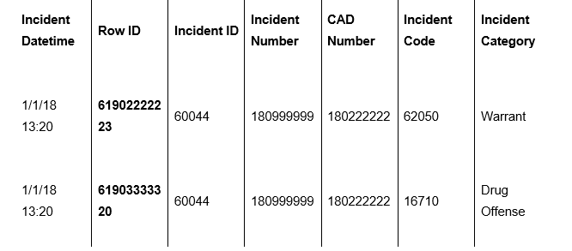
Methodology- Data Collection(Continued)
Before performing data analysis certain steps were taken to clean the data .
To prevent duplication of incident reports, supplemental reports tied to an initial report were not included in the data analysis.
When incident reports had multiple incident codes the row ID field was used as a unique identifier.
Figure 1: Example of incident report with multiple codes

Slide 9
Methodology- Data Collection(Continued)
This data set does not capture certain information
Citations are not captured unless associated with an incident report.
Records involving juveniles have been withheld from this data set per California Government code
All records coded as confidential

Slide 10
Methodology- Data Analysis
Exploratory Data Analysis (EDA)
Purpose: To gain insights into the dataset, identify patterns, anomalies, and relationships between variables.
Techniques:
Summary statistics (mean, median, mode, standard deviation)
Data visualization (histograms, box plots, scatter plots)
Correlation analysis
Spatial Analysis
Purpose: To analyze geographic data and understand spatial patterns and relationships.
Techniques:
Mapping (heatmaps, choropleth maps)
Spatial clustering (DBSCAN, K-means)
Geographic Information Systems (GIS)

Slide 11
Methodology- Data Analysis(Continued)
Cluster Analysis
Purpose: To group similar data points together based on their characteristics.
Techniques:
K-means clustering
DBSCAN clustering
Hierarchical clustering

Slide 12
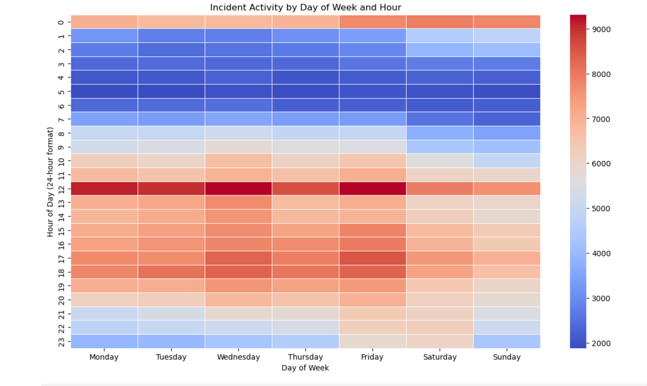
Results- Temporal Patterns
This Figure visualizes crime activity patterns based on the day of the week and hour of the day. Key findings include:
Peak Hours: Crime activity is concentrated in the late evening and early morning hours, particularly between 10 PM and 4 AM.
Weekday vs. Weekend: Weekends tend to have higher crime rates compared to weekdays.

Slide 13
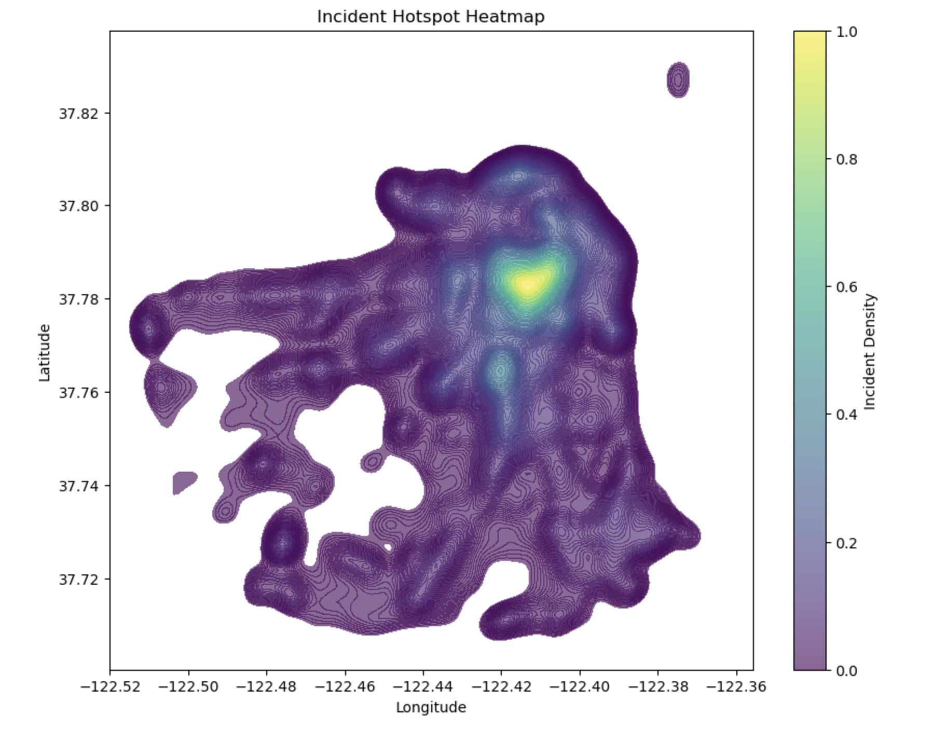
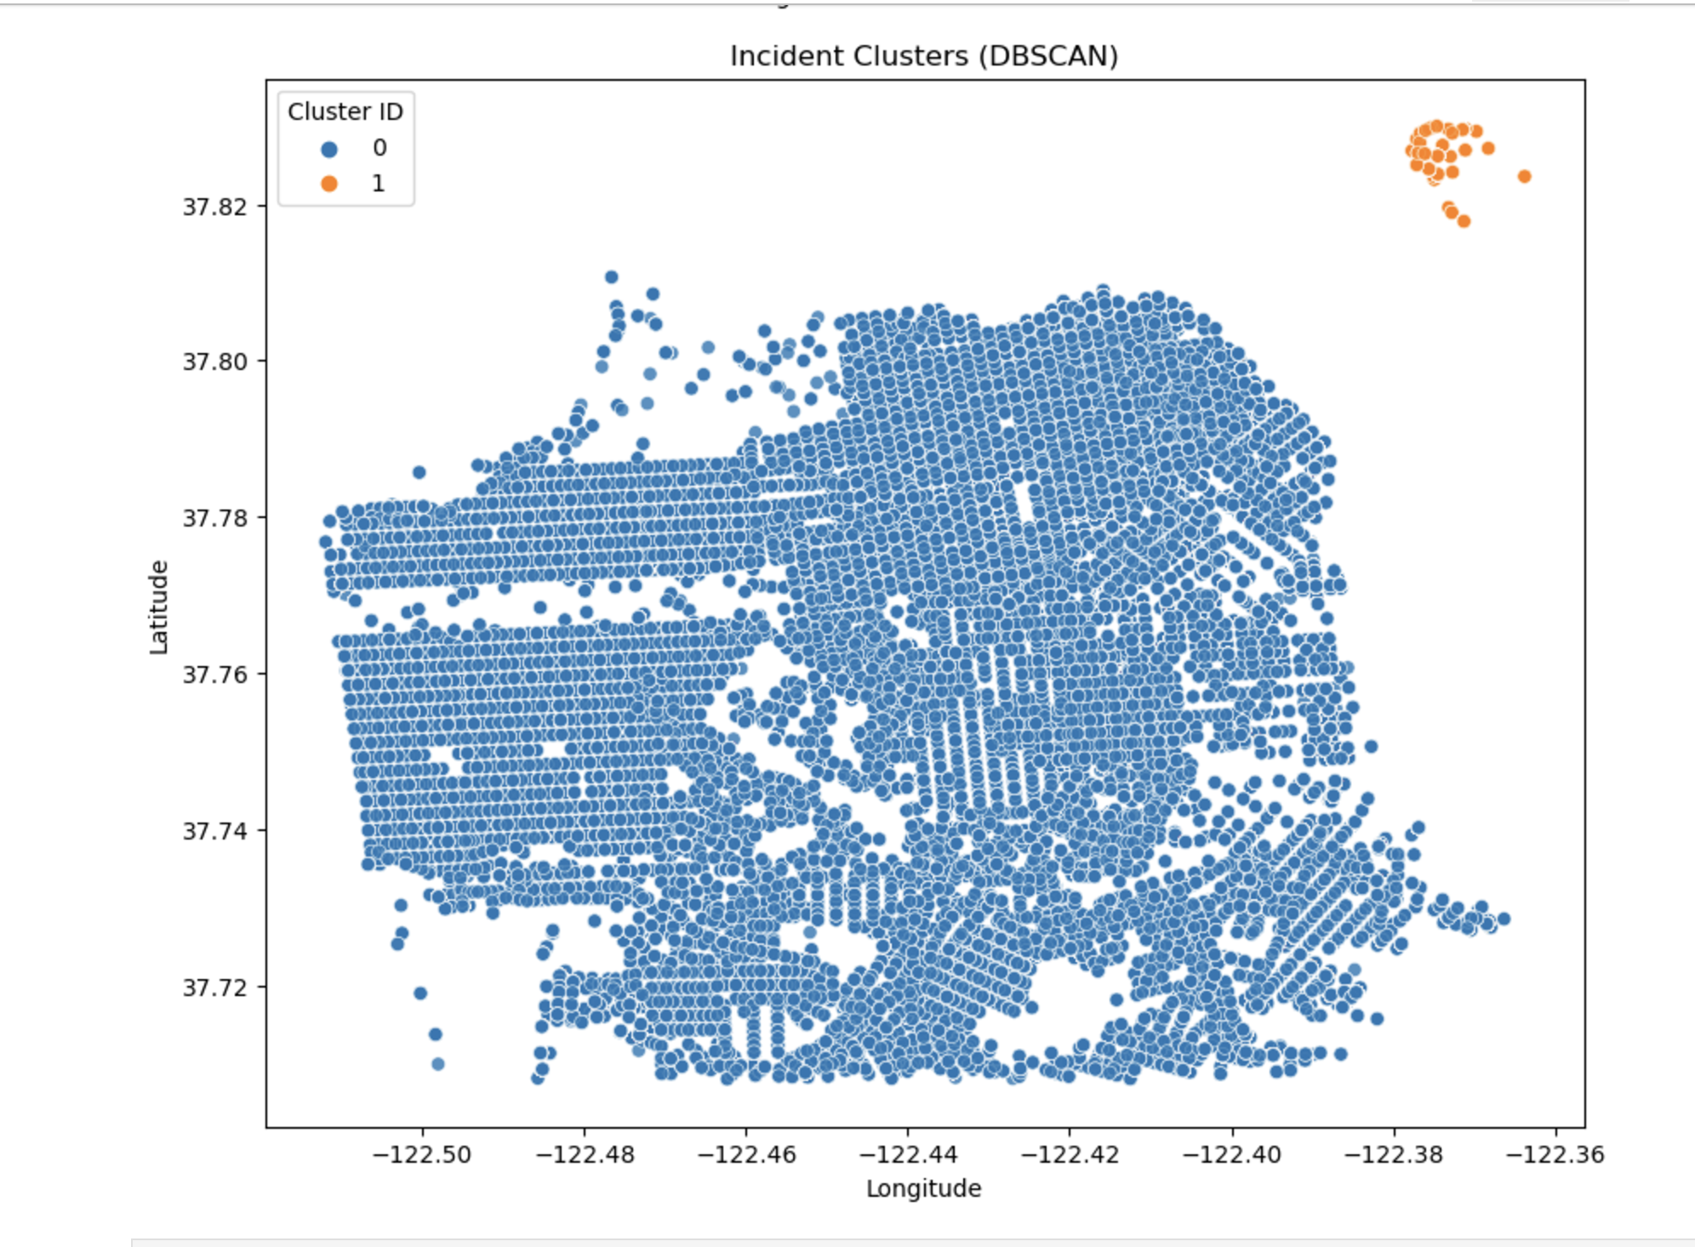
Results- Geospatial Patterns
Hotspot Identification: Certain areas in the city, particularly in the central and southern districts, exhibit higher crime densities.
Spatial Clustering: The DBSCAN algorithm has identified distinct clusters of incidents, suggesting localized hotspots.

Slide 14
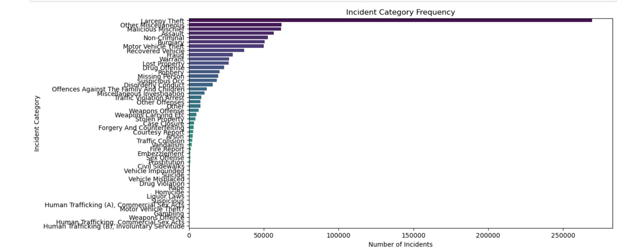
Results- Incident Patterns
This above visualizes the frequency of different incident categories. Key findings include:
Most Frequent Categories: Larceny-Theft, followed by Other Offenses and Vehicle Theft, are the most commonly reported incident categories.

Slide 15
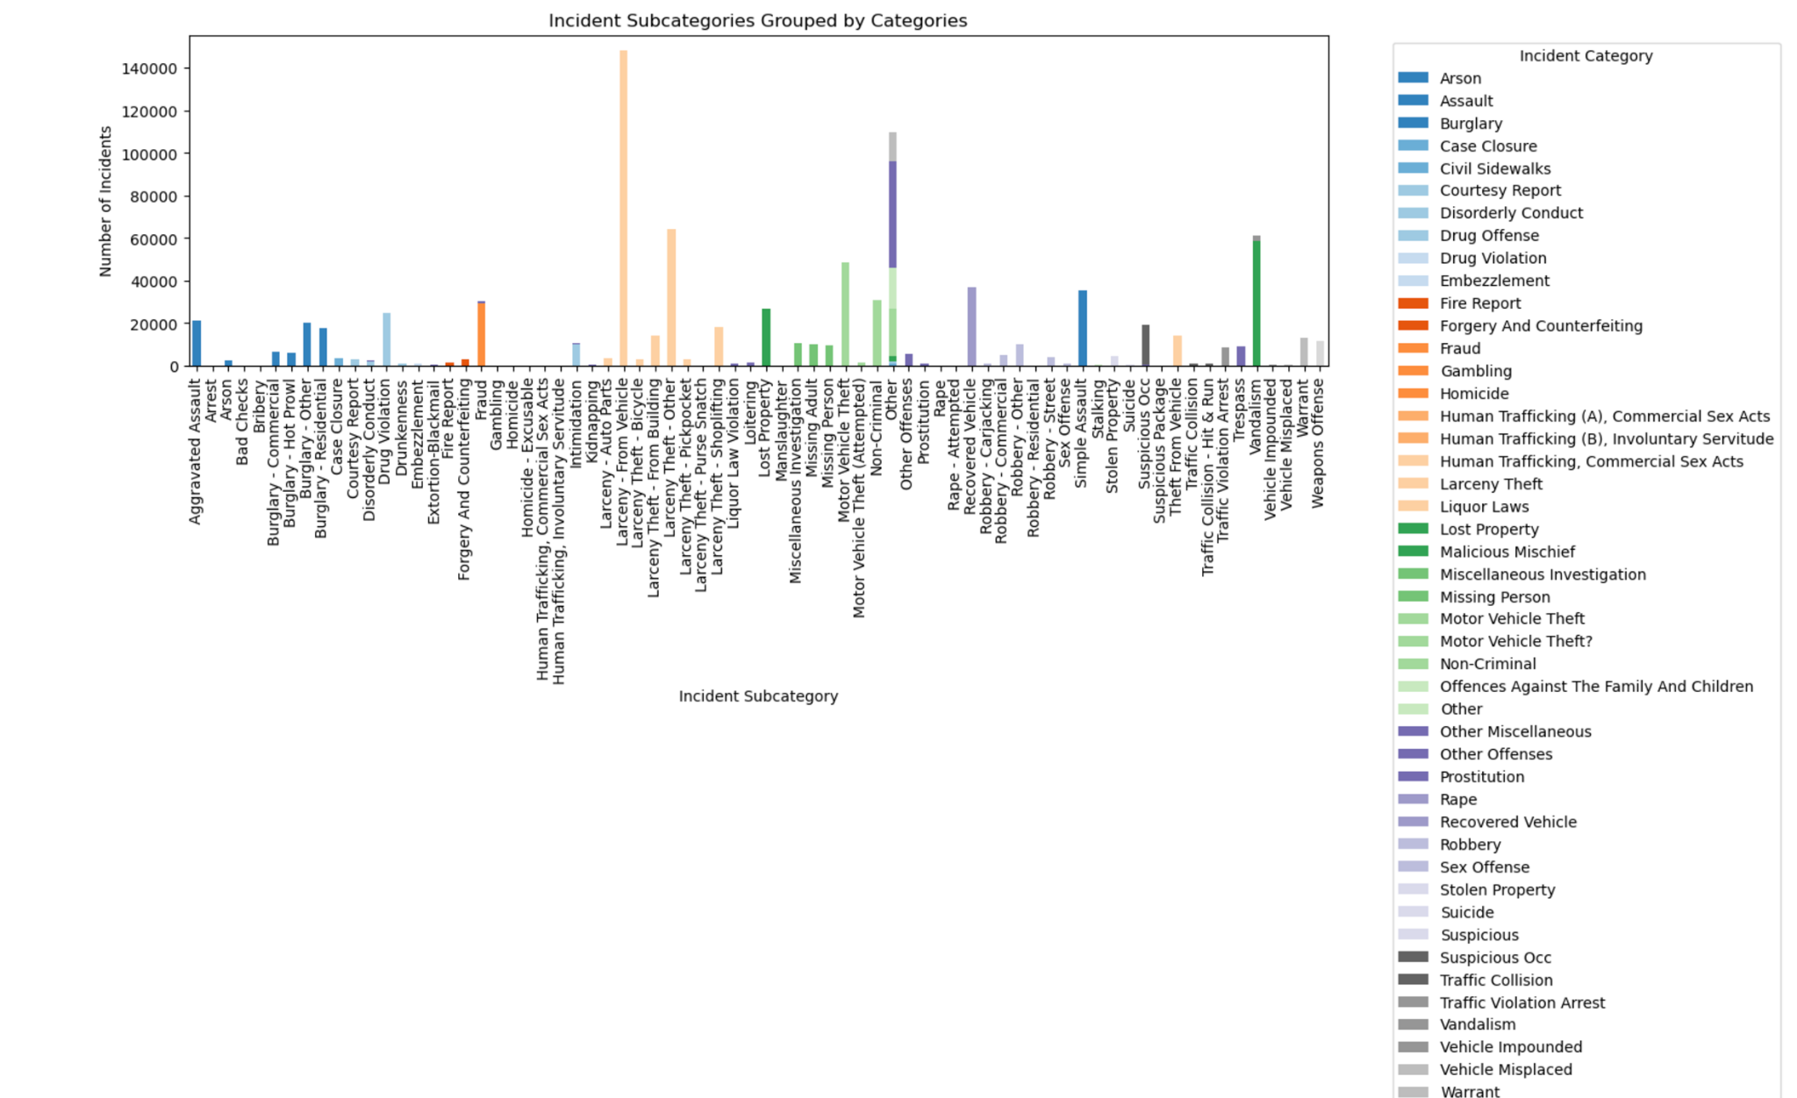
Results- Incident Patterns
This above visualizes the frequency of different incident subcategories within each major category. Key findings include:
Most Frequent Subcategories: Within Larceny-Theft, "From Vehicle" is the most frequent subcategory.
Other Frequent Subcategories: Other subcategories like Vandalism, Motor Vehicle Theft, and Recovered Vehicle are also relatively common.

Slide 16
Results- Incident Patterns
This above visualizes the frequency of different incident subcategories within each major category. Key findings include:
Most Frequent Subcategories: Within Larceny-Theft, "From Vehicle" is the most frequent subcategory.
Other Frequent Subcategories: Other subcategories like Vandalism, Motor Vehicle Theft, and Recovered Vehicle are also relatively common.

Slide 17
How Project Can Positive Contribute To Emergency Response
Resource allocation & response optimization
Identifying trends and community needs
Community engagement and trust building
Improved interagency Collaboration

